Slide 1

데이터 관리와 분석 프로젝트 #1
2조
이용은 황영석 강영은 이정원
평화의 숨결, 아시아의 미래
17회 인천아시안게임
Conceptual DB Design

Slide 2
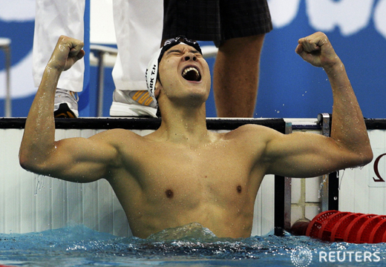
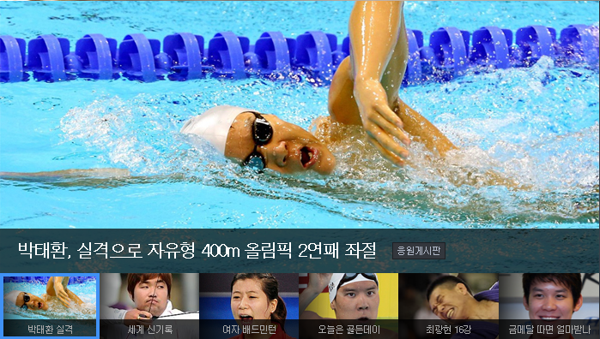

Slide 3
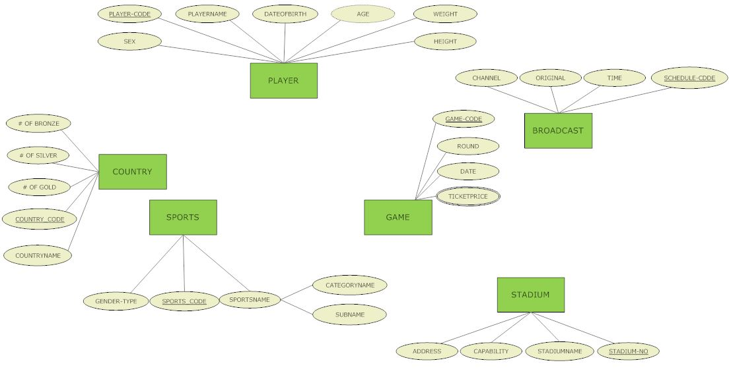
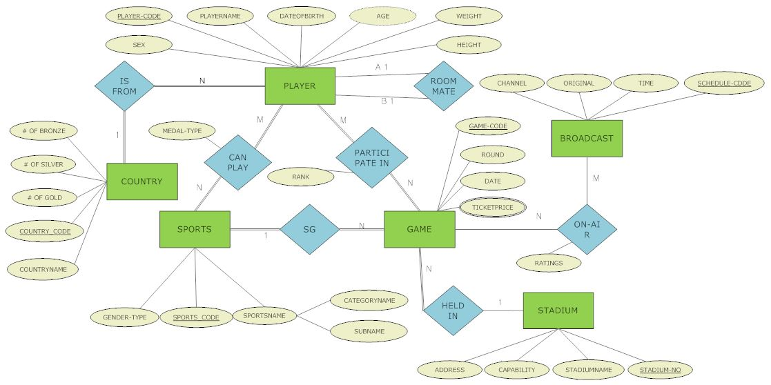
ER다이어그램

Slide 4
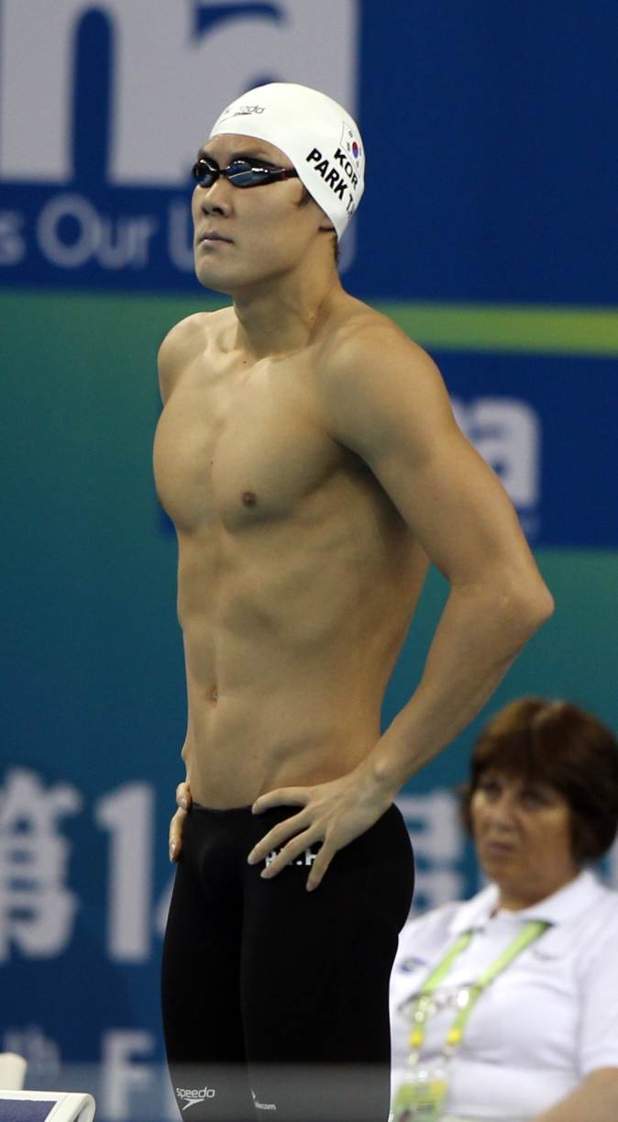
ER다이어그램
1. Entity: PLAYER
PLAYER_CODE(PK) : 00320124
PLAYERNAME : Park Tae Hwan
SEX : M
DATEOFBIRTH : 89/09/27
AGE(Derived) : 25
WEIGHT : 76
HEIGHT : 183

Slide 5
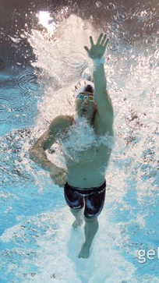
ER다이어그램
1. Entity: SPORTS
SPORTS_CODE(PK) :2314
GENDER-TYPE : Male
SPORTS_NAME = CATEGORY_NAME+SUB_THEME
: Swimming +100m Male Freestyle,

Slide 6
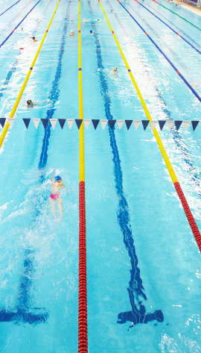
ER다이어그램
1. Entity: GAME
GAME_CODE(PK) : 40012792
ROUND : 10
DATE : 14/09/29 1830EST 9/24/2014
TICKETPRICE(multi valued) :
{50,30,20}

Slide 7
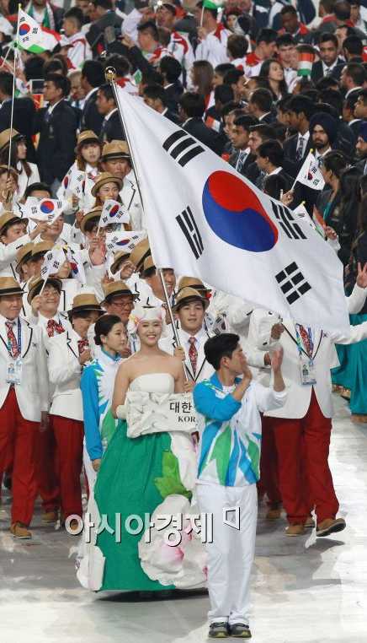
ER다이어그램
1. Entity: COUNTRY
COUNTRY_CODE(PK) : ROK
COUNTRY_NAME : Republic of Korea
# OF GOLD : 44
# OF SILVER : 50
# OF BRONZE : 52

Slide 8
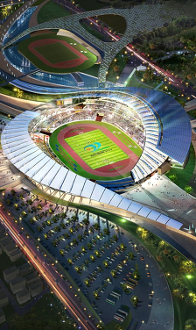
ER다이어그램
1. Entity: STADIUM
STADIUM_NO(PK) : 01
ADDRESS : 300 Asiangame-ro Song-do Incheon
CAPABILITY : 61818
STADIUMNAME : ParkTaeHwan Swim Stadium

Slide 9
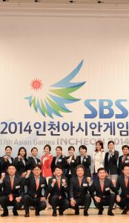
ER다이어그램
1. Entity: BROADCAST
SCHEDULE_CODE(PK) :
00238756-2837592
CHANNEL : SBS
TIME : 2000 EST 9/26/2014
ORIGINAL : 00238756-2836432

Slide 10
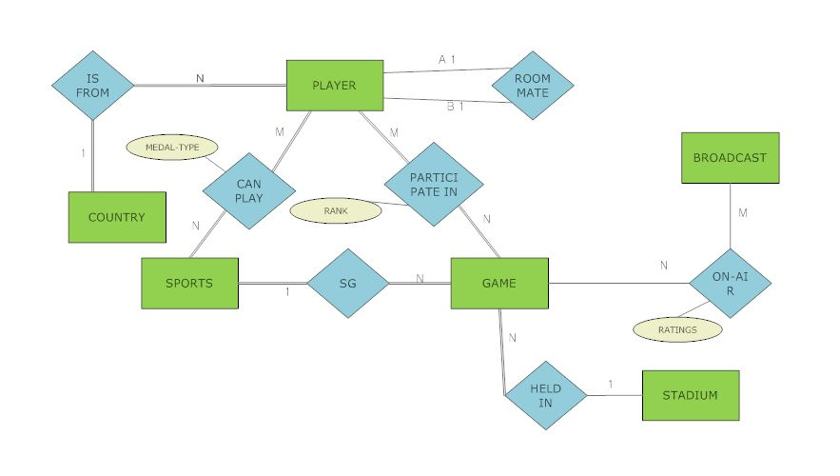
ER다이어그램

Slide 11
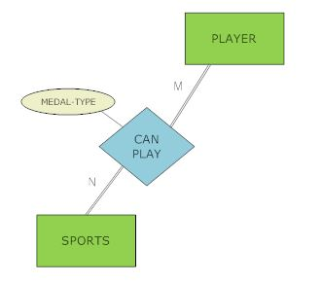
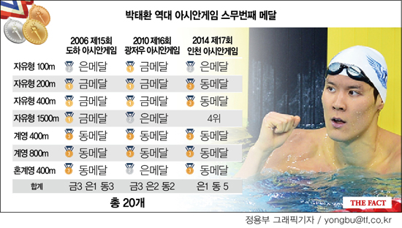
ER다이어그램
2. Relationship: CAN PLAY(player-sports)

Slide 12
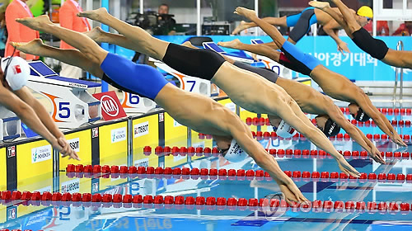
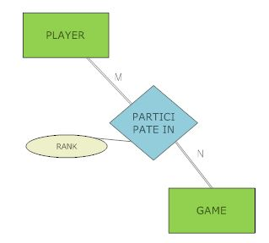
ER다이어그램
2. Relationship: PARTICIPATE IN(player-game)

Slide 13
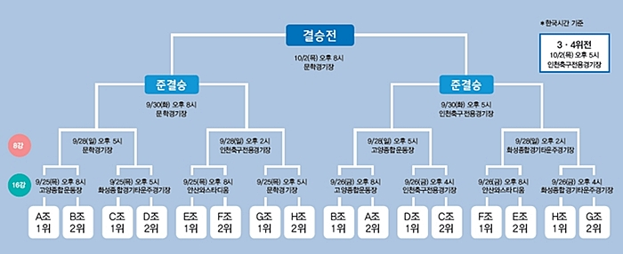
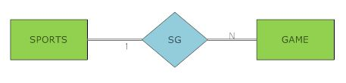
ER다이어그램
2. Relationship: SG(sports-game)

Slide 14
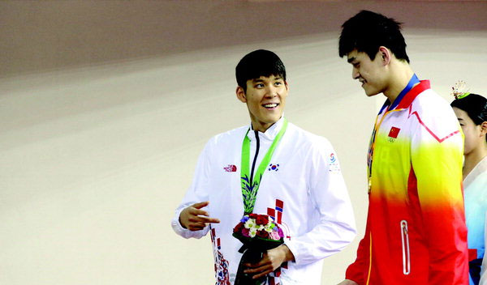
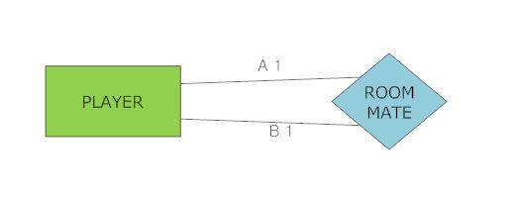
ER다이어그램
2. Relationship: ROOMATE(player-player)

Slide 15
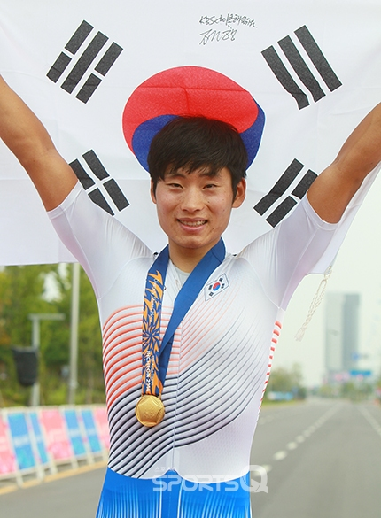
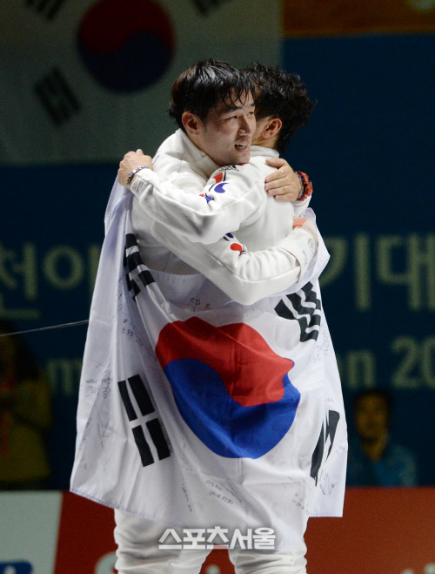
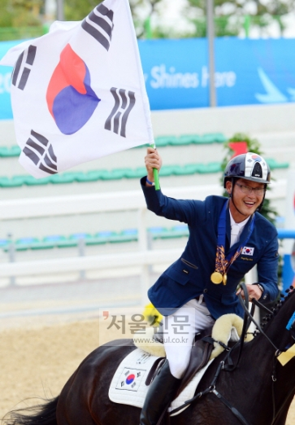
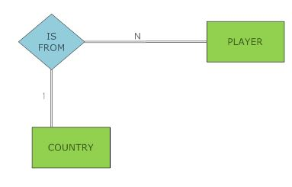
ER다이어그램
2. Relationship: IS FROM(player-country)

Slide 16
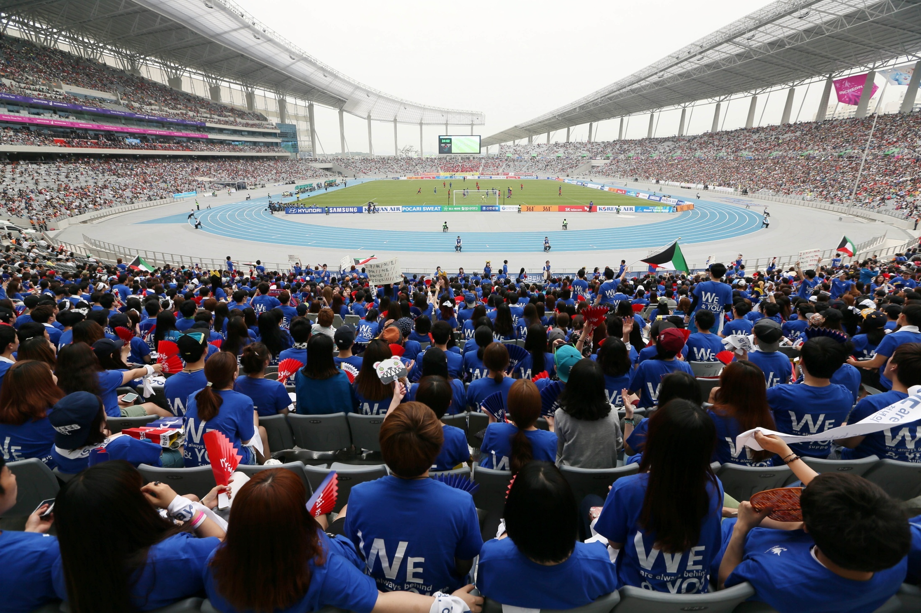
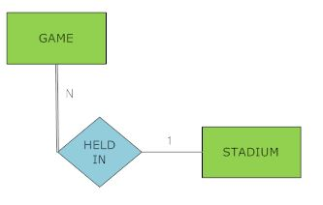
ER다이어그램
2. Relationship: HELD IN(stadium-game)

Slide 17
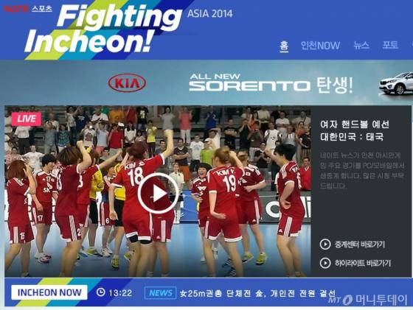
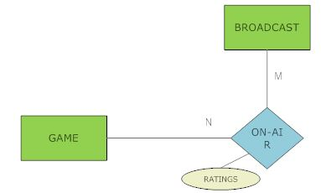
ER다이어그램
2. Relationship: ON-AIR(broadcast-game)

Slide 18
ER다이어그램

Slide 19
스키마 다이어그램
Schema
Diagram
PLAYER
Player_code | Playername | Dateofbirth | Sex | Age | Weight | Height | RM_code | Nationality
SPORTS
Sports_code | Category_name | Sub_theme | Gender_type
GAME
TICKET_PRICE
Game_code | Round | Date | Kind_of_sports | Venue
Game_code | Ticket_price
COUNTRY
Country_code | Country_name | #_of_gold | #_of_silver | #_of_bronze
STADIUM
Stadium_num | Stadium_name | Capability | Address
BROADCAST
Schedule_ID | Channel | Time | Original

Slide 20
스키마 다이어그램
Schema
Diagram
PLAYER
Player_code | Playername | Dateofbirth | Sex | Age | Weight | Height | RM_code | Nationality
SPORTS
Sports_code | Category_name | Sub_theme | Gender_type
GAME
TICKET_PRICE
Game_code | Round | Date | Kind_of_sports | Venue
Game_code | Ticket_price
COUNTRY
Country_code | Country_name | #_of_gold | #_of_silver | #_of_bronze
STADIUM
Stadium_num | Stadium_name | Capability | Address
BROADCAST
Schedule_ID | Channel | Time | Original

Slide 21
스키마 다이어그램
Schema
Diagram
PLAYER
Player_code | Playername | Dateofbirth | Sex | Age | Weight | Height | RM_code | Nationality
SPORTS
Sports_code | Category_name | Sub_theme | Gender_type
GAME
Game_code | Round | Date | Kind_of_sports | Venue

Slide 22
스키마 다이어그램
Schema
Diagram
PLAYER
Player_code | Playername | Dateofbirth | Sex | Age | Weight | Height | RM_code | Nationality
CAN_PLAY
Player_code | Sports_code | Medal_type
PARTICIPATE_IN
Player_code | Game_code | Rank
GAME
Game_code | Round | Date | Kind_of_sports | Venue
SPORTS
Sports_code | Category_name | Sub_theme | Gender_type

Slide 23
스키마 다이어그램
Schema
Diagram
PLAYER
Player_code | Playername | Dateofbirth | Sex | Age | Weight | Height | RM_code | Nationality
CAN_PLAY
Player_code | Sports_code | Medal_type
PARTICIPATE_IN
Player_code | Game_code | Rank
GAME
Game_code | Round | Date | Kind_of_sports | Venue
SPORTS
Sports_code | Category_name | Sub_theme | Gender_type

Slide 24
스키마 다이어그램
Schema
Diagram
PLAYER
Player_code | Playername | Dateofbirth | Sex | Age | Weight | Height | RM_code | Nationality
SPORTS
Sports_code | Category_name | Sub_theme | Gender_type
GAME
Game_code | Round | Date | Kind_of_sports | Venue
COUNTRY
Country_code | Country_name | #_of_gold | #_of_silver | #_of_bronze
STADIUM
Stadium_num | Stadium_name | Capability | Address
BROADCAST
Schedule_ID | Channel | Time | Original

Slide 25
스키마 다이어그램
Schema
Diagram
PLAYER
Player_code | Playername | Dateofbirth | Sex | Age | Weight | Height | RM_code | Nationality
SPORTS
Sports_code | Category_name | Sub_theme | Gender_type
GAME
Game_code | Round | Date | Kind_of_sports | Venue
COUNTRY
Country_code | Country_name | #_of_gold | #_of_silver | #_of_bronze
STADIUM
Stadium_num | Stadium_name | Capability | Address
BROADCAST
Schedule_ID | Channel | Time | Original

Slide 26
스키마 다이어그램
Schema
Diagram
GAME
Game_code | Round | Date | Kind_of_sports | Venue
ON_AIR
Schedule_ID | Game_code | Ratings
BROADCAST
Schedule_ID | Channel | Time | Original

Slide 27
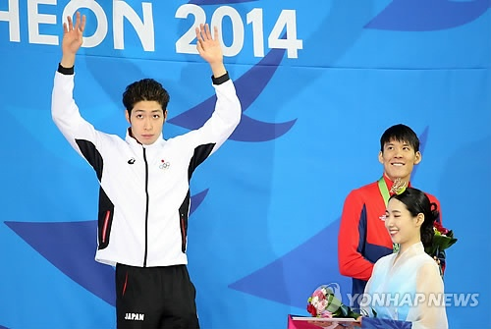
조회 시나리오
Johoi
Scenario
각 종목별로 우승한 선수들의 연령이 어떻게 될까?
남자 자유형 200M
→ 20
CAN_PLAY | Player_code | Sports_code | Medal_type
 | 1520512 | 1200 | Gold
 | 1520512 | 1202 | Null
 | 1510001 | 3101 | Bronze
 | 1210013 | 3101 | Silver
 | 1510001 | 3124 | Gold
 | 1210013 | 3124 | Silver
 | 2412045 | 2015 | Null
 | 2412045 | 4712 | Null
CHAMPION ← πPlayer_code, Sports_code(σ(Medal_type=Gold)(CAN_PLAY))
CHAMPION | Player_code | Sports_code
 | 1520512 | 1200
 | 1510001 | 3124

Slide 28
조회 시나리오
Johoi
Scenario
각 종목별로 우승한 선수들의 연령이 어떻게 될까?
PLAYER | Player_code | Playername | Dateofbirth | Sex | Age | Weight | Height | RM_code | Nationality
 | 1510001 | Park Taehwan | 89/09/27 | M | 25 | 86 | 183 | 1520512 | KOR
 | 1210013 | Sun Yang | 91/12/01 | M | 22 | 89 | 198 | 1221452 | CHN
 | 1520512 | Lee Yongeun | 91/08/21 | M | 23 | 65 | 100 | 1510001 | KOR
 | 2412045 | Enes Kaya | 84/08/22 | M | 30 | 70 | 140 | 2421551 | IRI
 | 1515001 | Heo Jaeseok | 88/01/01 | M | 26 | 72 | 160 | 1523221 | KOR
PLAYER_AGE ← πPlayer_code, Age(PLAYER)
PLAYER_AGE | Player_code | Age
 | 1510001 | 25
 | 1210013 | 22
 | 1520512 | 23
 | 2412045 | 30
 | 1515001 | 26

Slide 29
조회 시나리오
Johoi
Scenario
각 종목별로 우승한 선수들의 연령이 어떻게 될까?
PLAYER_AGE | Player_code | Age
 | 1510001 | 25
 | 1210013 | 22
 | 1520512 | 23
 | 2412045 | 30
 | 1515001 | 26
CHAMPION | Player_code | Sports_code
 | 1520512 | 1200
 | 1510001 | 3124
PLAYER_CHAM ← πSports_code, Age (PLAYER_AGE * CHAMPION)
CHAMPION | Sports_code | Age
 | 1200 | 23
 | 3124 | 25

Slide 30
통계 분석 시나리오
Scenario
각 종목별로 우승한 선수들의 연령
CHAMPION | Sports_code | Age
 | 1200 | 23
 | 3124 | 25
각 종목별 선수들의 나이
AGES | Player_code | Sports_code | AGE
 | 1520512 | 1200 | 23
 | 1510001 | 1200 | 25
 | 2420412 | 1200 | 29
 | 1222151 | 1200 | 21
 | 1710014 | 1200 | 30
 | 3010051 | 1200 | 21
종목별로 평균을 내어서
나온 평균치들

Slide 31
통계 분석 시나리오
Scenario
각 종목별로 우승한 선수들의 연령
종목별 우승자와
전체 참가자의
연령 비교
종목별로 평균을 내어서
나온 평균치들

Slide 32
